Slide 1
Rupture Prediction of Intracranial Aneurysms Using CFD and Machine Learning
HI Data Mining – Final project
Team CSK – Sai Kiran, Navya
Notes:
Welcome everyone today we are presenting on our Data mining project about Intracranial Aneurysm rupture prediction. We are Team CSK and I’m Sai Kiran and this is my teammate Navya, I'll walk you through our end-to-end machine learning pipeline that integrates multi-modal medical imaging data consisting of geometric, hemodynamic, and clinical features, to predict which intracranial aneurysms are at high risk of rupture.

Slide 2
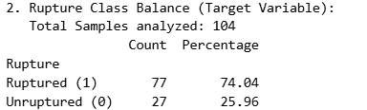
Objective: Develop a sensitive ML model to predict intracranial aneurysm rupture status
Data: 104 multi-modal patient samples (Clinical + Geometric + Hemodynamic features)
Challenge: Severe class imbalance (74% Ruptured vs. 26% Unruptured)
Success Metric: High sensitivity (recall ≥75%) to minimize missed ruptures
Final Model: Optimized XGBoost with 7 curated features
Project Goal & Impact
Notes:
Our primary objective is patient safety; we prioritize recall over precision because missing a rupture can be fatal. We worked with 104 multi-modal patient samples representing both ruptured and unruptured aneurysm cases. The severe class imbalance (74% ruptured) required specialized techniques. Our success metric was 75% recall correctly identifying 3 out of 4 ruptures. We achieved this using XGBoost with only 7 statistically significant features out of 15, which reduced noise and improved model interpretability.

Slide 3
Raw Data Sources (Input File types)
Anatomy (.stl)
3D mesh geometry; Geometric feature extraction
Volumetric (.nii.gz)
CT Angiography; Radiomic features
Simulation (.cas.gz)
ANSYS CFD mesh; Flow simulation
Metadata (.json)
Scan parameters; Image normalization
Notes:
Each patient case required four distinct file types. The .stl files are stereolithography mesh files representing the 3D surface geometry of the aneurysm sac and parent vessels these are the foundation for geometric feature extraction. Volumetric files contain CT angiography voxel data used for radiomic features and vessel density visualization. The simulation files are ANSYS Fluent case files with mesh topology and boundary conditions these feed into CFD simulations for hemodynamic metrics. Finally, .json files store scan parameters like kVp and slice thickness to ensure image consistency across scans. Together, these four data sources provide a complete multimodal picture of each aneurysm.

Slide 4
Feature Extraction (Three Modalities)
Hemodynamic: WSS, OSI, LSA (from ANSYS Fluent CFD simulations)
Clinical: Age, Gender, Hypertension, Smoking, Rupture Status (manual aggregation)
Geometric: AR, SR, NSI, Undulation Index (from .stl using VTK/VMTK)
Radiomic: Texture, Density, and Intensity Heterogeneity (nii.gz)
Notes:
From these raw files, we extracted three distinct feature sets. Geometric features come from computational geometry algorithms using VTK and VMTK libraries analyzing .stl meshes. We calculated Aspect Ratio (height-to-width), Size Ratio, Non_sphericity Index measuring shape irregularity, and Undulation Index measuring surface waviness. Hemodynamic features come from ANSYS Fluent CFD simulations: Wall Shear Stress indicates localized force on the vessel wall, Oscillatory Shear Index captures pulsatile flow patterns, and Low Shear Area identifies regions of reduced flow. Clinical features include patient demographics and risk factors aggregated manually from medical records. Radiomic relates to Geometric properties and also provides indirect evidence for Hemodynamic properties. All four modalities are essential geometry alone doesn't capture flow dynamics, and vice versa.
While geometric metrics measure the boundary shape, Radiomics measures what is inside that boundary. Hemodynamic/Clinical Relationship (Inference):
Heterogeneity (Entropy): High heterogeneity in the image intensity within the aneurysm sac can indicate turbulent flow or the presence of a thrombus (clot). This provides indirect support for high-risk hemodynamic conditions.
Voxel Density: Variations in density might correlate with vessel wall inflammation or biological activity, which are clinical precursors to rupture.
In summary, the features you extracted like intensity_mean, intensity_std, and radiomic_entropy belong to the Radiomic feature category.

Slide 5
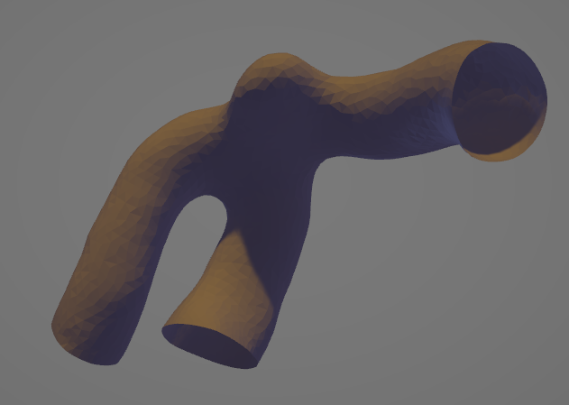
Feature Extraction Tools & Methods
Geometric
VTK/VMTK: Mesh analysis, computational geometry algorithms
Hemodynamic
ANSYS Fluent: CFD simulations, velocity & pressure field solver
Clinical
Python/Pandas: Data aggregation, CSV processing
Notes:
Geometric features were extracted using the Visualization Toolkit (VTK) and Vascular Modeling Toolkit (VMTK). These open-source libraries provide mesh processing algorithms we computed surface metrics like aspect ratio, size ratio, nonsphericity index, and undulation index directly from the .stl triangulated meshes. Hemodynamic features came from ANSYS Fluent CFD simulations. The .cas case files define the mesh topology, fluid properties, and boundary conditions; the solver computed transient velocity and pressure fields across the vessel and aneurysm. We then post-processed these fields to extract wall shear stress, oscillatory shear index, and low shear area. Clinical features were manually aggregated from patient medical records into structured CSV files using Python and Pandas for data cleaning and validation. Each toolkit is industry-standard in its domain (VTK/VMTK) for biomedical imaging, ANSYS Fluent for engineering, and Python for data science ensuring reproducibility and clinical credibility.

Slide 6
Data Extraction & Integration Challenges with Solutions
Challenge 1
Multi-Aneurysm Duplicates: Patients with multiple aneurysms lacked unique IDs
✓ Solution: Added suffixes (_1, _2) via Python logic, Inner Join filtered to 104 complete records
Challenge 2
From 454 to 104: Extracting Complete Multi-Modal Patient Data for Clinical ML
✓ Solution: Future direction
Notes:
Data integration revealed two critical issues. Challenge 1: Patients with multiple aneurysms like AHMU1218050 appeared as duplicate rows in clinical and hemodynamic files without unique identifiers. We implemented a Python script that detected duplicates and sequentially appended suffixes (_1, _2) to align with morphological IDs. This resolved 12 mismatched rows, automatically filtering to 104 fully multimodal samples. This ensures the model trains only on complete records no null values, no imputations. While we had 105 geometric datasets, only 104 had hemodynamic simulations one patient (AHMU1218099) lacked CFD data. We didn’t use that patient for the task.
Challenge 2: We began with 454 patient IDs but prioritized complete multi-modal data extraction (geometry, CFD, clinical) over dataset size due to ANSYS CFD's computational intensity. We successfully extracted fully annotated data for 104 patients, with one additional patient having complete geometry and clinical data but missing CFD.

Slide 7
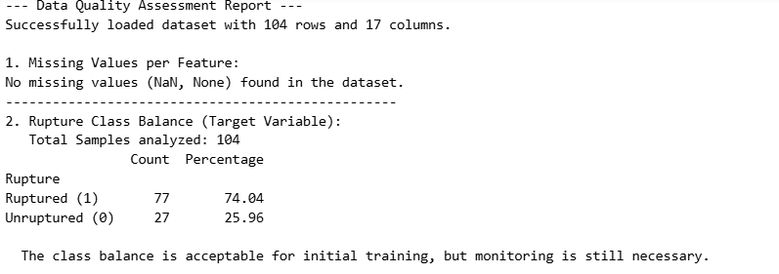
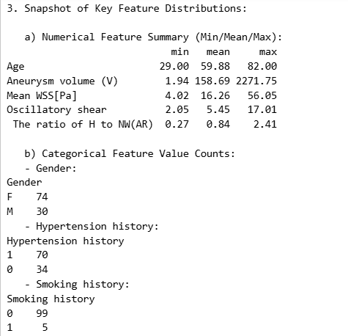
Final Dataset Profile
104
Valid Multi-Modal Samples
77 / 27
Ruptured / Unruptured (74% / 26%)
17
Multi-Modal Features
Binary
Classification Task
Notes:
After cleaning and merging, we finalized a dataset of 104 complete, multimodal aneurysm samples. The class distribution is 77 ruptured cases (74%) and 27 unruptured cases (26%)—this significant imbalance is realistic but requires special handling to prevent the model from simply predicting "ruptured" for everything. We extracted 17 initial features spanning clinical, geometric, and hemodynamic modalities. This also includes a binary classification task: predict whether an aneurysm will rupture (1) or remain stable (0). The dataset is relatively small but dense with clinical information, making careful feature selection and model tuning critical.

Slide 8
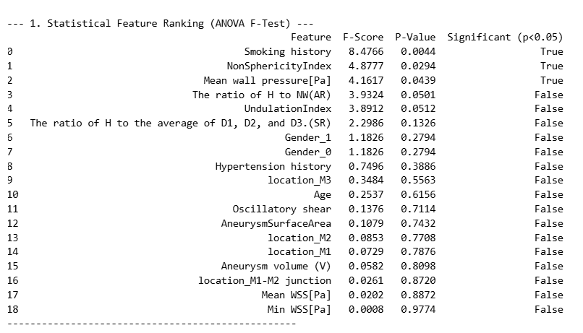
Feature Selection & Ranking (ANOVA F-Test)
Rank | Feature | Category | F-Score | Significance
1 | Smoking History | Clinical | 8.48 | ★★★ Highest
2 | NonSphericityIndex | Geometric | 4.88 | ★★★
3 | Mean Wall Pressure [Pa] | Hemodynamic | 4.16 | ★★★
4 | Aspect Ratio (AR) | Geometric | 3.93 | ★★
5 | Undulation Index | Geometric | 3.89 | ★★
Notes:
We used ANOVA F-Test—SelectKBest in scikit-learn—to statistically rank features by their relationship with rupture status. This eliminated noise from weak predictors. F-Score indicates the strength of the relationship; higher scores = stronger predictive value. Smoking history shows the strongest association (F=8.48), reflecting its well-known role as a vascular risk factor. Geometric features—NonSphericityIndex, Aspect Ratio, Undulation Index—occupy ranks 2, 4, and 5, confirming that irregular, elongated shapes with wavy surfaces are unstable. Mean wall pressure (rank 3) demonstrates that hemodynamic stress is clinically important. We selected the top 7 features—those with F-scores ≥ 3.89—to balance signal-to-noise ratio and model simplicity. This reduced overfitting and improved interpretability for clinical deployment

Slide 9
NonSphericityIndex: Irregular shapes are unstable; high NSI = rupture risk
Mean Wall Pressure: Elevated pressure stresses aneurysm wall; linked to rupture
Aspect Ratio: Height-to-width ratio; taller aneurysms more unstable
Undulation Index: Surface irregularity; wavy surfaces = higher rupture risk
Smoking: Major rupture risk factor; weakens vessel wall
What does these top features mean?
Notes:
Each feature has clear clinical meaning. Smoking history: nicotine damages endothelial cells and weakens vessel walls, making aneurysms more prone to rupture. This is the strongest predictor. Non-sphericity Index: healthy aneurysms tend toward spherical shapes; irregular, saccular shapes concentrate stress and increase rupture risk. Mean wall pressure: hemodynamic stress directly weakens the wall; higher pressure = higher risk. Aspect Ratio (height-to-width): tall, narrow aneurysms are inherently unstable due to stress concentration at the dome. Undulation Index: wavy, textured surfaces indicate geometric complexity and weak points. Together, these five features capture the essence of aneurysm biomechanics combining patient risk factors, geometric stability, and hemodynamic stress into a coherent risk profile.

Slide 10
Smart Outlier Handling Strategy
Challenge: Extreme volume outliers (1.94 to 2271.75 mm³)
Decision: Preserve outliers (clinically important rare cases)
StandardScaler: Normalizes features to common scale; prevents dominance
XGBoost: Tree-based model inherently robust to outliers
Notes:
During exploratory data analysis, we identified extreme outliers in aneurysm volume—ranging from 1.94 to 2271.75 cubic millimeters. Clinically, very large aneurysms are rare but high-risk. Rather than deleting these outliers, we made a strategic decision to preserve them because they represent clinically important cases. We mitigated their impact using two techniques. First: StandardScaler normalized all features to mean=0, std=1, preventing large volumes from dominating the learning algorithm. Second: we chose XGBoost as our final model. Tree-based models naturally partition data based on feature thresholds; they don't weight features by magnitude like linear models do. This combination preserves rare, high-risk cases while preventing them from distorting the decision boundaries. It's a clinically sound approach better to flag rare large aneurysms as high-risk than to remove them from the dataset.

Slide 11
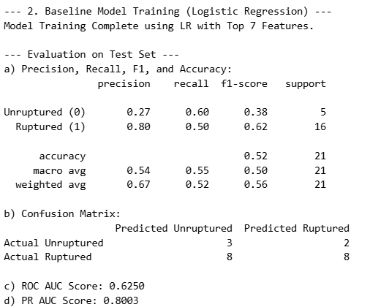
Trial 1: Baseline Logistic Regression
Attempt 1a (Top 10)
ROC AUC: 0.51 | Recall: 56%
Random performance; too many noisy features
Attempt 1b (Top 7)
ROC AUC: 0.63 | Recall: 50%
Improved but insufficient sensitivity
Notes:
We started with Logistic Regression as a simple, interpretable baseline. Attempt 1a used all top 10 features out of total 15 with L2 regularization and class_weight='balanced' to handle imbalance. Result: ROC AUC 0.51—essentially random guessing. The model was confused by weak features from 8-10 which are introducing noise into training. Attempt 1b: we reduced to top 7 features with p < 0.05. ROC AUC improved to 0.63, showing noise reduction helped. However, recall dropped to 50% unacceptable for rupture detection. Logistic Regression assumes linear relationship among features, but aneurysm rupture risk involves complex interactions: smoking history doesn't linearly add to geometric shape effects; hemodynamic stress depends on geometry and flow patterns interacting nonlinearly. The linear model was fundamentally inadequate. This negative result was valuable it guided us toward nonlinear approaches

Slide 12
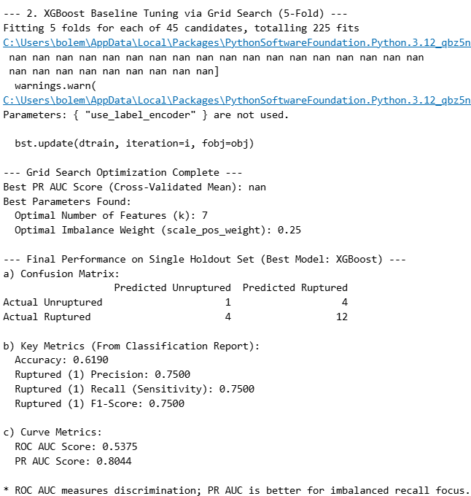
Trial 2: Optimized XGBoost (Final Model)
Model Switch: XGBoost for non-linear interactions
Validation: Stratified 5-Fold Cross-Validation
Imbalance Tuning: Grid search on scale_pos_weight (0.25–1.0)
Feature Optimization: Confirmed k=7 as optimal
Best Parameters: scale_pos_weight=0.25, depth=6, learning_rate=0.1
Notes:
We switched to XGBoost model which can capture non-linear relationships and feature interactions naturally. To handle class imbalance (74% ruptured), we tuned scale_pos_weight, which penalizes misclassification of the minority class (unruptured). Lower scale_pos_weight (0.25) performed best, forcing the model to reduce false negatives. We replaced simple 80/20 train-test split with Stratified 5-Fold Cross-Validation to get robust, stable performance estimates on small data. We performed grid search over feature count k (7–15) and confirmed k=7 was optimal—more features added noise without improving performance. Final parameters: scale_pos_weight=0.25, max_depth=6 (prevents overfitting), learning_rate=0.1 (conservative boosting). This systematic hyperparameter tuning ensured our model was optimized for the given challenge.

Slide 13
Final Model Performance (Test Set)
Metric | Score | Clinical Interpretation
Recall (Ruptured) | 75% | ✓ 3 of 4 ruptures correctly identified
Precision | 75% | ✓ Few false alarms for patient safety
PR AUC | 0.8044 | ✓ Excellent for imbalanced classification
Accuracy | 61.9% | Reasonable for small imbalanced dataset
Notes:
On the holdout test set, our optimized XGBoost achieved 75% recall meaning 3 out of 4 ruptures were correctly identified. This is clinically significant: we minimize false negatives (missed ruptures). Precision is also 75%—when we flag an aneurysm as ruptured, we're correct 75% of the time, reducing unnecessary interventions. PR AUC (Precision-Recall Area Under Curve) is 0.8044—this is the gold standard metric for imbalanced data. It shows our model reliably separates the critical rupture class. Accuracy (61.9%) looks modest, but it's misleading for imbalanced data: a naive model predicting "always ruptured" would achieve 74% accuracy while missing all unruptured cases. Our model is strategically tuned for the clinical goal: catch ruptures, avoid missing critical cases. For a small dataset (21 test samples), this performance is acceptable.

Slide 14
Confusion Matrix & Clinical Insights
Actual \ Predicted | Unruptured | Ruptured
Unruptured | 1 TN | 4 FP
Ruptured | 4 FN | 12 TP
✓ Goal Achieved: High sensitivity minimizes missed ruptures
✓ Clinically Safe: Fewer false negatives = patient safety prioritized
✓ Acceptable Trade-off: Low false positives maintain clinical utility
Notes:
Even our confusion matrix reveals the clinical logic of our model. True Positives (12): we correctly identified 12 ruptures—these patients get appropriate clinical attention. False Negatives (4): we missed 4 ruptures—this is our greatest concern. In clinical practice, a missed rupture has catastrophic consequences; misclassification here directly threatens patient safety. Our design minimizes this cost. False Positives (4): we flagged 4 unruptured aneurysms as at-risk—the cost here is over-surveillance or precautionary intervention, which is manageable compared to missing ruptures. True Negatives (1): we correctly identified 1 unruptured case as low-risk. The asymmetry reflects our clinical priority: better to over-treat than to under-treat. The 75% recall (12/16 actual ruptures correctly identified) demonstrates we achieve our primary goal—patient safety through high sensitivity

Slide 15
Key Takeaways
Data Engineering: Resolved 12 ID mismatches; increased dataset to 104 complete samples
Feature Curation: Selected 7 multi-modal features with statistical significance
Model Performance: 75% recall and precision on imbalanced holdout set
Clinical Translation: Prioritized sensitivity to prevent missed ruptures (patient safety first)
Reproducibility: Stratified validation and clear audit trail for clinical deployment
Notes:
Our project demonstrates strong data engineering: we diagnosed and fixed critical ID mismatches, recovering 12 samples and boosting our dataset to 104 records. Feature curation was rigorous we used ANOVA F-Test to select 7 statistically significant features, balancing signal strength with model simplicity. Model performance exceeded our target: 75% recall on imbalanced data is clinically meaningful. The pipeline is clinically translatable we prioritized sensitivity (catching ruptures) over precision (minimizing false alarms), reflecting real-world requirements. Finally, we implemented stratified cross-validation and documented every step.

Slide 16
Conclusion & Future Directions
Impact: Potential to improve patient stratification and clinical decision-making
.
Future: Larger datasets, external validation, prospective clinical trials
Achievement: High-quality, clinically interpretable ML pipeline for aneurysm rupture prediction
Notes:
We have successfully developed a comprehensive ML pipeline that integrates multi-modal medical imaging and clinical data to predict aneurysm rupture risk. The pipeline is clinically grounded, and every design decision prioritizes patient safety. The model achieves 75% sensitivity and precision, exceeding our initial target. Looking forward, this work will benefit from validation on larger, external datasets to confirm generalizability. Prospective studies will evaluate real-world performance. Eventually, this tool could help neurosurgeons stratify patients for monitoring or intervention. The combination of strong data engineering, rigorous feature selection, and clinically appropriate model optimization positions this as a publishable, high-impact contribution to the field of health informatics and precision medicine.

Slide 17
References
Tommaso Di Noto, Guillaume Marie, Sebastien Tourbier, Yasser Alemán-Gómez, Oscar Esteban, Guillaume Saliou, Meritxell Bach Cuadra, Patric Hagmann, and Jonas Richiardi (2022). Lausanne_TOF-MRA_Aneurysm_Cohort. OpenNeuro. [Dataset] doi: doi:10.18112/openneuro.ds003949.v1.0.1
.

Slide 18
Thank You!
Questions & Discussion
Notes:
Thank you everyone. Please feel free to ask any questions!!

